Slide 1

BANGALORE INSTITUTE OF TECHNOLOGY
K.R Road, V.V Pura, Bengaluru-04
DEPARTMENT OF ARTIFICIAL INTELLIGENCE & MACHINE LEARNING
INTERNSHIP
“Technical Intern, Regulatory Reporting Team, Société Générale”
Presented by
Name – Vishal S B
USN - 1BI20AI055
VIII Semester
Under the Guidance of
Prof. YAMINI SAHUKAR P
Assistant Professor

Slide 2
Agenda
Introduction
Objectives
About Company / Organization
Tasks Assigned & Performed
Tools / Technologies Used
Skills Acquired
Architecture
Algorithm / Implementation Details
Results
Applications
Conclusion (With Reflection Outcomes - Communication Skills, Collaborative Synergy, Effective Time Management etc.)

Slide 3
Introduction
Expertise: Our team is proficient in regulatory and compliance reporting, leveraging tools such as Selenium and Python for web automation to ensure accuracy and efficiency.
Critical Role: We ensure regulatory compliance and data integrity, utilizing our technical skills to enhance reporting processes and safeguard organizational data.
Innovation: We are committed to innovating our reporting and automation practices, continuously adapting to emerging technologies to improve our processes.
Client-Centric: We tailor our reporting solutions to meet the specific needs of our clients, providing dedicated support and ensuring their requirements are precisely met.

Slide 4
Objectives
Enhance Reporting Efficiency: Implement advanced automation techniques using Selenium and Python to streamline reporting processes, reducing manual effort and increasing accuracy.
Ensure Regulatory Compliance: Develop robust reporting frameworks that adhere to regulatory standards, minimizing the risk of non-compliance and potential penalties.
Optimize Data Integrity: Implement stringent data validation measures to maintain the integrity and reliability of organizational data throughout the reporting lifecycle.
Enhance Security Measures: Implement robust security protocols to safeguard sensitive data during the reporting and automation processes, ensuring confidentiality and integrity.

Slide 5

About Company
Establishment: Société Générale Global Solution Centre was founded in 2011 as a service center for the Société Générale.
Services: It provides a wide range of services and solutions like Finance & Accounting, Human Resources, IT, Know Your Customer or Compliance.
Subsidiary: Société Générale Global Solution Centre is a 100% owned subsidiary of Société Generali.
Global Impact: It provides services to Société Générale's business lines around the world.
Work Culture: Being part of the Société Générale Global Solution Centre team means working in a dynamic, active environment where your work has a real impact on the business.

Slide 6
Tasks Assigned & Performed
1. Web automation for Regulatory Reporting:
Task Assigned: Create a python-based application to collect the required data from the client’s site and reformat into a compliance report and submit it to the regulatory bodies like ESMA(European Securities and Markets Authority), SEBI(Securities and Exchange Board of India), SEC(Securities and Exchange Commission) etc.
Task Performed: Successfully set up a web automation application and integrated it with the tkinter Gui, facilitating automatic reporting based on regular intervals of time.

Slide 7
Tasks Assigned & Performed
2. Dashboard for Stock Prediction and Analysis:
Task Assigned: Develop a dashboard for stock prediction and analysis using various techniques such as yfinance, SARIMA(Seasonal Autoregressive Integrated Moving Average) model, LSTM(Long Short-Term Memory) neural networks, and mplfinance packages.
Task Performed: Successfully created a comprehensive dashboard capable of predicting stock movements for the next 30 candles based on the specified time frame. Utilized yfinance for fetching stock data, implemented SARIMA model and LSTM neural networks for predictive analysis, and integrated mplfinance packages for visualization.

Slide 8
Tasks Assigned & Performed
3.Django CRUD Operations and Flask Service Deployment on Azure
Task Assigned: The objective was to showcase the capabilities of Django by implementing Create, Read, Update, and Delete (CRUD) operations within a Django application. Additionally, the task involved hosting a backend service using Flask and deploying it on Azure Web Services.
Task Performed: The task was successfully completed with the demonstration of CRUD operations in a Django application. This involved creating a robust and dynamic web application that allowed users to create, read, update, and delete data seamlessly.

Slide 9
Tools / Technologies Used
Selenium
Django
Flask
Azure Web Services
Python for ML
Vs Code
Yfinance
Mlpfinance
MongoDb

Slide 10
Skills Acquired
Web Automation: Automating tasks on the web, often using tools like Selenium.
Web Development: Creating websites or web applications, involving frontend and backend development.
Compliance and Regulatory Reporting: Ensuring adherence to relevant laws and regulations, and generating necessary reports.
Backend Services: Services handling the ‘behind-the-scenes’ functionality of web applications.
Tkinter: A Python interface to the Tk GUI toolkit, used for creating GUIs.
Azure Web Services: Microsoft’s cloud computing service offering a range of cloud services.

Slide 11
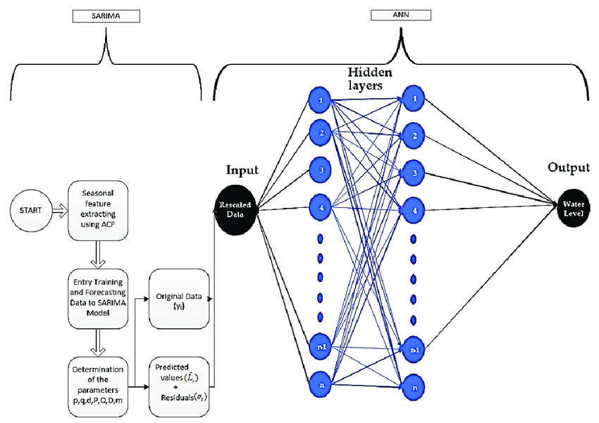
Architecture
SARIMA

Slide 12
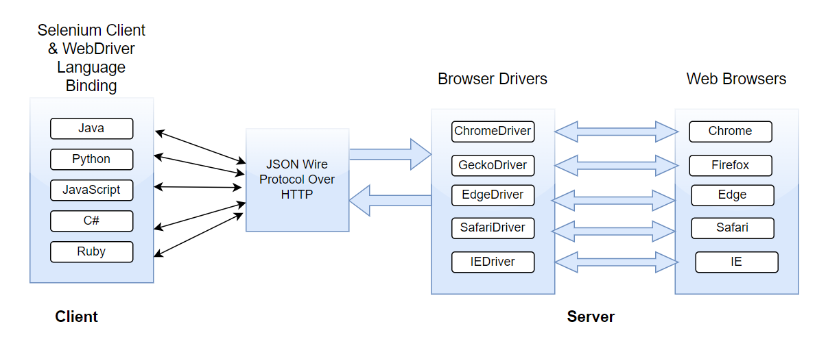
Architecture
SELENIUM WEBDRIVER API

Slide 13
Implementation Details
1. Web automation for Regulatory Reporting:
Data Collection: Used web scraping libraries in Python such as BeautifulSoup or Scrapy to collect the required data from the client’s site.
Data Processing: Used a library like Pandas to clean and transform the collected data into the required format for the compliance report.
Report Generation: Used a library like ReportLab or Pandas to generate a compliance report from the processed data.
Automatic Submission: Implemented a function to automatically submit the generated report to the regulatory bodies at regular intervals of time.
GUI Integration: Integrated the application with a GUI to facilitate user interaction and control over the reporting process.

Slide 14
Implementation Details
2. Dashboard for Stock Prediction and Analysis:
Data Collection: Utilized yfinance to fetch the necessary stock data from Yahoo Finance.
Predictive Analysis: Developed predictive models using SARIMA for statistical forecasting and LSTM neural networks for time series prediction.
Visualization: Employed mplfinance to create candlestick charts, which are a visual representation of price movements in a specified time period. These charts were used to plot both the actual stock data and the predicted data from the models.
Dashboard Creation: All these elements were integrated into a comprehensive dashboard. This dashboard provides an interactive interface for users, allowing them to choose the stock, set the time frame, run the predictive models, and view the resulting predictions and visualizations.

Slide 15
Implementation Details
3. Django CRUD Operations and Flask Service Deployment on Azure
Django CRUD Operations: A Django application was set up and configured. Within this application, Create, Read, Update, and Delete (CRUD) operations were implemented. This allowed users to interact with the data in a seamless manner.
Flask Backend Service: A backend service was developed using the Flask framework. This service was designed to be lightweight and modular, which ensured efficient data handling and processing.
Deployment on Azure: The Flask service was then deployed on Azure Web Services. This involved configuring the Azure environment, setting up the necessary resources, and deploying the Flask application.

Slide 16
Results
Set up a web automation application using Python and integrated it with the tkinter GUI.
Facilitated automatic reporting based on regular intervals of time.
Developed a dashboard for stock prediction and analysis using various techniques such as yfinance, SARIMA model, LSTM neural networks, and mplfinance packages.
Predicted stock movements for the next 30 candles based on the specified time frame and resulted with 113.2 MAE.
Implemented Create, Read, Update, and Delete (CRUD) operations within a Django application.
Developed a backend service using Flask and deployed it on Azure Web Services.

Slide 17
Applications
Enhanced User Experience and Performance: Leveraged Django CRUD operations to streamline data management, improving application responsiveness and user experience. Implemented web automation to handle high traffic scenarios, ensuring seamless performance.
Cost and Time Efficiency: Utilized Tkinter for creating lightweight desktop applications, reducing the need for expensive web hosting services. Automated repetitive tasks using web automation, saving valuable time and resources.
Predictive Analysis and Decision Making: Developed a Dashboard for Stock Prediction using LSTM and Sarima models, providing accurate forecasts and aiding in strategic decision making.

Slide 18
Applications
Streamlined Development: Integrated various technologies like Django, Tkinter, LSTM(Long Short-Term Memory), and Sarima(Seasonal Autoregressive Integrated Moving Average) to create a cohesive project, automating various aspects of the development process.
Data Integrity and Availability: Ensured the accuracy and reliability of stock predictions through vigilant monitoring and fine-tuning of LSTM and Sarima models. This commitment to data integrity provided reliable insights for users.

Slide 19
Conclusion
Efficient Task Execution: Demonstrated precision and efficiency in task execution by automating repetitive tasks using web automation and creating efficient data management systems with Django CRUD operations.
Enhanced Application Performance: The implementation of LSTM and Sarima models in the Dashboard for Stock Prediction significantly improved the accuracy of stock predictions, enhancing overall performance. The use of Django CRUD operations also improved the responsiveness and user experience of web applications.
Cost Optimization: Utilized Tkinter for creating lightweight desktop applications, reducing the need for expensive web hosting services. Automated repetitive tasks using web automation, saving valuable time and resources.

Slide 20
Conclusion
Streamlined Development Processes: Integrated various technologies like Django, Tkinter, LSTM, and Sarima to create a cohesive project, automating various aspects of the development process.
Reflection Outcomes:
Communication Skills: Effective communication facilitated issue resolution and conflict resolution.
Effective Time Management: The strategic prioritization of tasks coupled with a steadfast commitment to meeting established deadlines fostered a heightened level of discipline and efficiency.
Collaborative Synergy: Leveraged the power of teamwork to drive project success, fostering an environment of mutual respect, open communication, and collective problem-solving.

Slide 21
THANK YOU

